Slide 1



Healthcare
FSA
Save over $900 a year on health expenses

Slide 2


Healthcare Flexible Spending Account (FSA)
A Healthcare FSA is a personal expense account, allowing you to set aside a portion of your salary pre-tax to pay for qualified medical expenses.

Slide 3






Healthcare Flexible Spending Account (FSA)
FAMILY
38K
EASY
$3200
COVERS YOUR WHOLE FAMILY
DIFFERENT WAYS TO USE YOUR FUNDS
MULTIPLE WAYS TO SUBMIT CLAIMS
MAXIMUM CONTRIBUTION

Slide 4
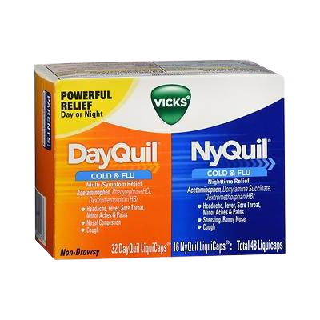
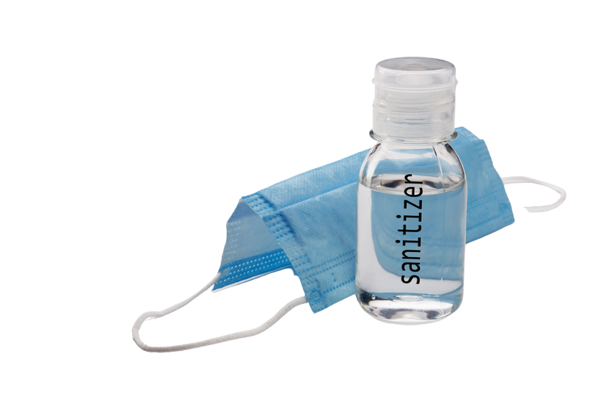
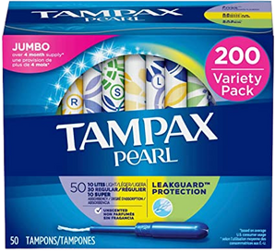
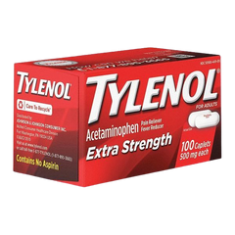
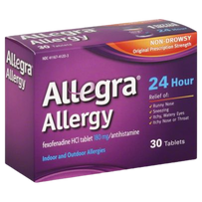
An FSA helps you pay for things you already buy
Over-the-counter (OTC) Medications
On average, U.S. households spend $338/year on OTC products like like Tylenol®, Zyrtec®, and cold medicine. With an FSA, you save $100 each year on those purchases.
Feminine Care Products
The average woman spends $300/year on feminine care products. With an FSA, you would save $90 each year.
Personal Protective Equipment (PPE)
Masks, hand sanitizer and sanitizing wipes that are purchased to prevent the spread of COVID-19 are now eligible expenses.

Slide 5

Pay 30% less on medical expenses
Tina typically spends $1,000 yearly on glasses and contact lenses. But this year she signed up for a Healthcare FSA and was able to purchase them tax-free which saved her $300
It's like free money!

Slide 6

Pay 30% less on medical expenses
Best of all, she can buy all her contacts at once!

Slide 7





How does it work?
Monthly paycheck deductions
Pay with debit card or submit claims!
Estimate your annual election
Funds are available immediately
DID YOU KNOW?
$1,400
Average annual election

Slide 8


38,000 ways to spend your FSA!
Capital improvements to your home, such as ramps,
railings and support bars
Mileage for travel to and
from healthcare
appointments
Night guards
Bandages and other medical supplies
Birth control
Breast pumps
Sunscreen
Vaccinations and immunizations
Over-the-counter drugs
Feminine care products
Home COVID-19 tests
Personal protective equipment (PPE)
Prescriptions
Copays & Coinsurance
Deductibles
Office Visits
Dental work
Orthodontia
Glasses & Contacts
Chiropractic
Massage
Acupuncture
Capital improvements to your home, such as ramps,
railings and support bars
Mileage for travel to and
from health appointments
Night guards
Bandages and other medical supplies
Birth control
Breast pumps
Sunscreen
Vaccinations and immunizations
Stop-smoking programs
Psychologists and therapy
Breast reconstruction surgery
Childbirth classes
Eye surgery, including laser eye surgery and Lasik
Fertility treatments and monitors
Flu shots
Hearing aids and batteries
Insulin
Lab fees
Physical therapy
Prescription sunglasses
Prosthesis

Slide 9


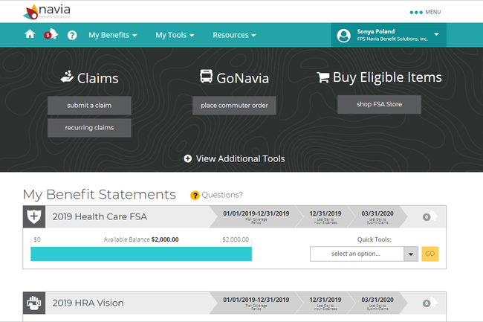
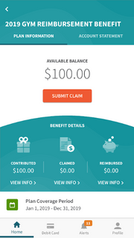



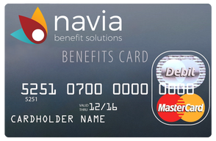
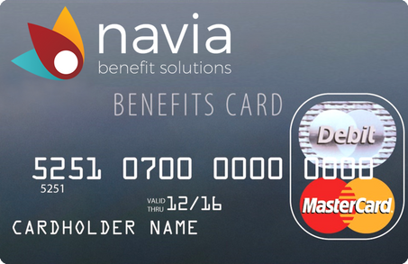
Accessing your benefits couldn’t be easier!
Navia Mobile Pay

Slide 10




Why should I enroll?
Save enough money to pay for three months of groceries or a gym membership for a year
Rest easy knowing you have emergency funds for unexpected costs
Don’t wait to get your son’s braces, new glasses, or that laser eye surgery you’ve always wanted
$900+ AVERAGE ANNUAL SAVINGS
EMERGENCY FUNDS
DON'T WAIT

Slide 11

How long do I have to file a claim?
Run-out periods vary by employer and typically last 60 to 90 days after the end of the plan year

Slide 12


Some plans let you carryover funds to the next year
$640
Carryover
Check your employer’s plan design to see if the Carryover feature is part of your plan.

Slide 13

Some plans give you extra time to incur expenses
2.5
MONTHS
Grace Period
Check your employer’s plan design to see if the Grace Period feature is part of your plan.

Slide 14

We've got you covered!
U.S.
45 sec
2 days
100% US-based, live customer support with offices in every time zone
If you have a question, you wait less than a minute to talk with a live Navia expert
Claims are turned around within 2 days to ensure you are reimbursed fast

Slide 15

Bottom line
If you plan on spending even a dollar out-of-pocket for healthcare this year, a tax-advantaged benefit account will save you an average of 30% on every expense.
Enroll now!

Slide 16

Day Care
FSA
Save up to $1,500 a year on day care expenses

Slide 17





Day Care Flexible Spending Account (FSA)
CARE
PAY
EASY
$5000
CHILDREN AND ELDERS COVERED
USE FUNDS TO PAY FAMILY
MULTIPLE WAYS TO SUBMIT CLAIMS
MAXIMUM CONTRIBUTION

Slide 18

Day Care FSA works like a bank account and saves you money
A Day Care FSA helps you pay for day care expenses that you already pay for out-of-pocket! This account works like a bank account, meaning you cannot be reimbursed for more that what is in your account at any given time.

Slide 19


Ways to spend your Day Care FSA!
Child care
Nanny or Au pair
Before and after school care
Day camps
Preschool
Elder care

Slide 20

Debit card and family care!
PAY A FAMILY MEMBER FOR DAY CARE
Easy debit card payments
Pay a family member for day care

Slide 21

Bottom line
If you plan on spending even a dollar out-of-pocket for healthcare this year, a tax-advantaged benefit account will save you an average of 30% on every expense.
Enroll now!

Slide 22


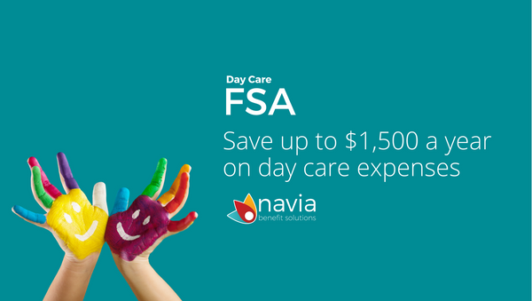

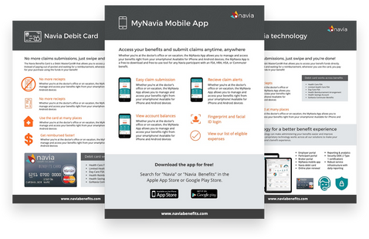


Education Resources
https://www.naviabenefits.com/benefit-education-resources

